Slide 1

CyberSecurity Project
Baioni Francesco
Caprari David
Cingolani Cristian
Mori Nicola
Sospetti Mattia

Slide 2
Topics
REQUIREMENT/DESIGN
Early/Late requirement analysis
Asset identification
Asset value/exposure assessment
Threat identification / Attack assessment
Control ident./Feasibility ass./Secuirity req. def.
IMPLEMENTATION/TESTING

Slide 3
REQUIREMENT/DESIGN

Slide 4
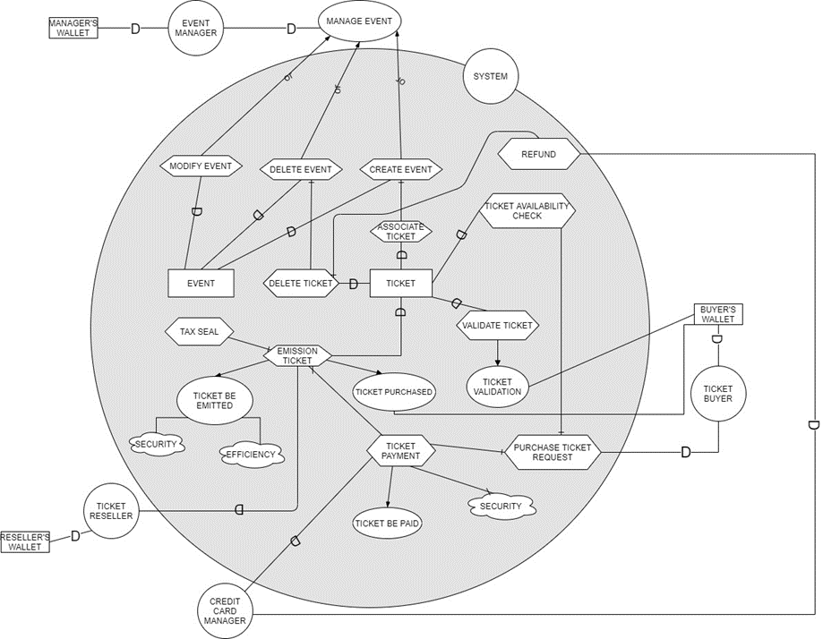
Early/Late requirement analysis
SD/SR i* model

Slide 5
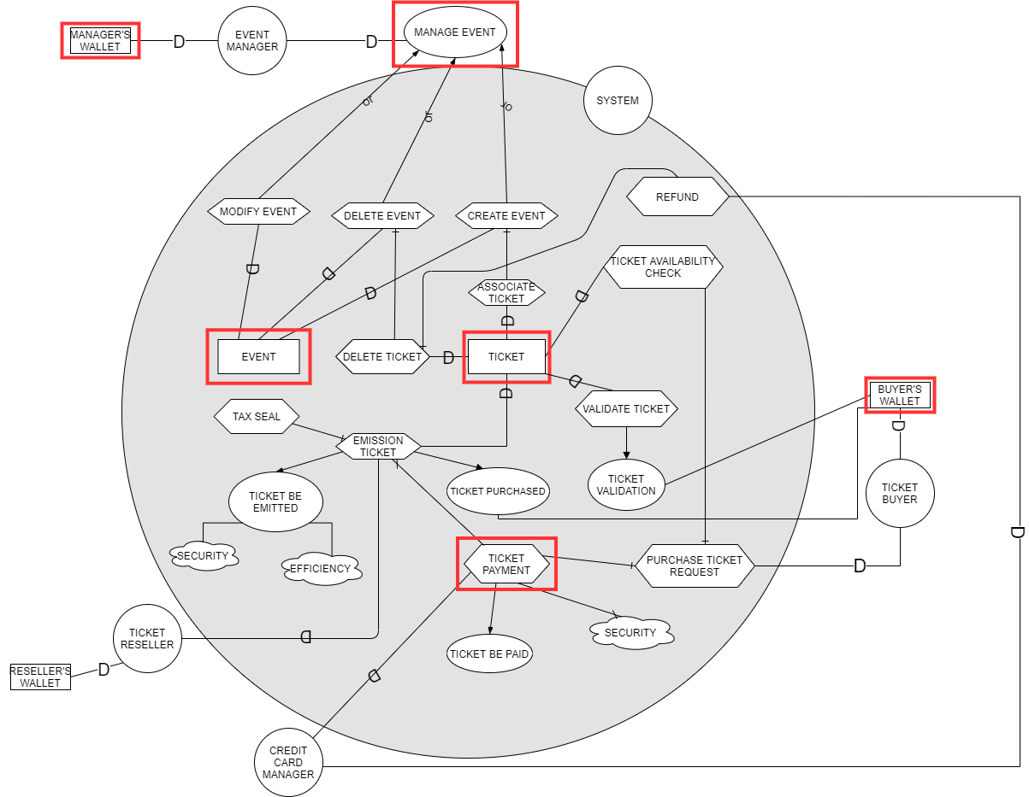
Asset identification

Slide 6
Asset identification
Use case specification
Use case ID: | U-MW-01
Use case name: | Manager's Wallet Utilization
Actors | Manager, System
Description | Manager's Wallet use for ticket registration
Data | Manager's Wallet
Stimulus and Preconditions | Events are registered by managers, system assigns ticket to managers' IDs
Basic Flow | 1. Manager manages events (create, delete, modify)
 | 2. System updates Manager's Wallet with ticket ID
Alternative Flow
Exception Flow | 1. Manager manages events (create, delete, modify)
 | 2. Wallet is not updated
Response and Postconditions | Confirmation that tickets have been assigned
Non functionals Requirements | CIA
Comments

Slide 7
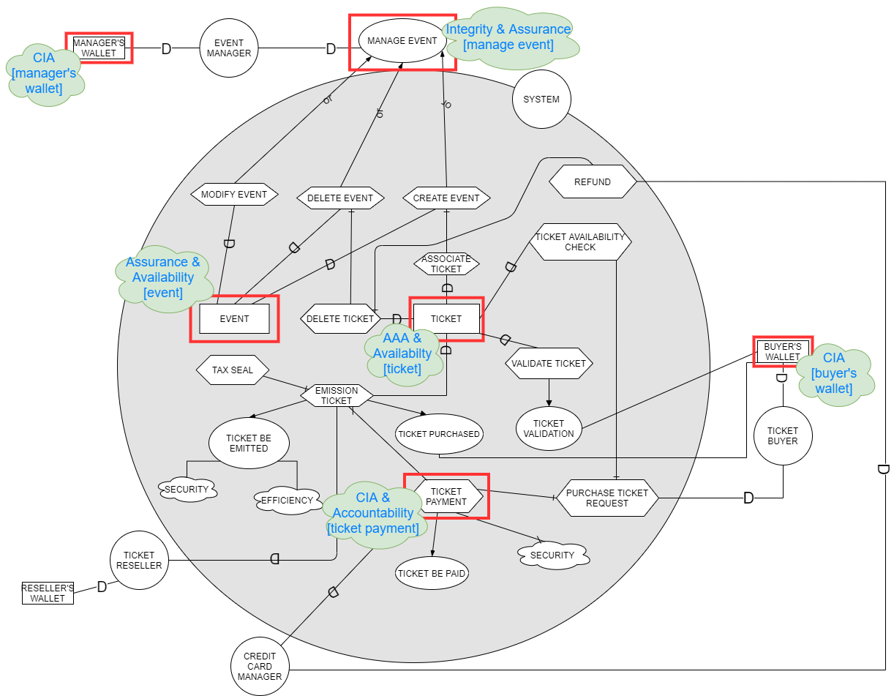
Asset identification
Policy

Slide 8
Asset value / Exposure assessment
ASSET | VALUE | VALUE DESCRIPTION | EXPOSURE | EXPOSURE DESCRIPTION
Manager's Wallet | 3 | However, it has its own relevance but does not have priority over other assets | 3 | Interference with ticket sales, organization problems
Manage Event | 4 | Event management plays a crucial role in the system | 4 | Deleting or modifying an event affects the entire system
Event | 4 | The event contains general information such as place, date, available seats ... | 3 | Changing the parameters of an event affects the entire system
Ticket | 5 | It has the highest priority for the centrality of the object | 4 | By modifying the parameters of a ticket, you act on the entire system and directly on the customer, affecting the division of the system and the organizers of the event
Ticket Payment | 4 | It affects both the buyer and the ticket | 5 | The presence of money makes this an important factor and contains sensitive data
Buyer's Wallet | 3 | However, it has its own relevance because it contains the ticket but does not have priority over the other assets | 2 | Loss of reputation due to customer dissatisfaction

Slide 9
Threat identification
Risk Mitigation and Mitigation Table
ASSET | Spoofing | Tampering | Repudiation | Information Disclosure | Dos | Elevation of Privilege
Manager's Wallet |  |  |  | X
 | X | X |  | X
 | X | X |  | X |  | X
 |  | X |  |  | X
Event | X | X |  |  |  | X
 |  | X |  |  | X
 | X | X
 | X | X
 |  | X | X
 | X | X |  |  |  | X
Ticket | X | X |  | X |  | X
 |  | X |  |  | X
 | X | X |  | X |  | X
 |  |  | X
 | X | X |  | X
 |  | X | X
 | X | X |  | X |  | X
Buyer's Wallet |  |  |  | X
 | X | X |  | X
 | X | X |  | X
 |  | X |  |  | X
System | X | X |  | X |  | X
 |  | X |  |  | X

Slide 10
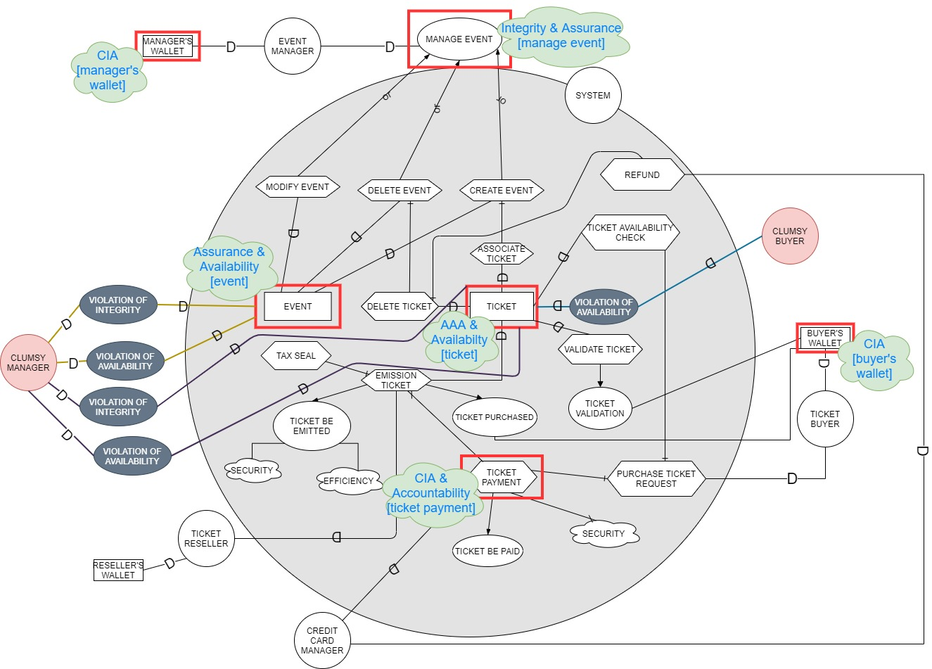
Threat identification / Attack assessment
Misuse case

Slide 11
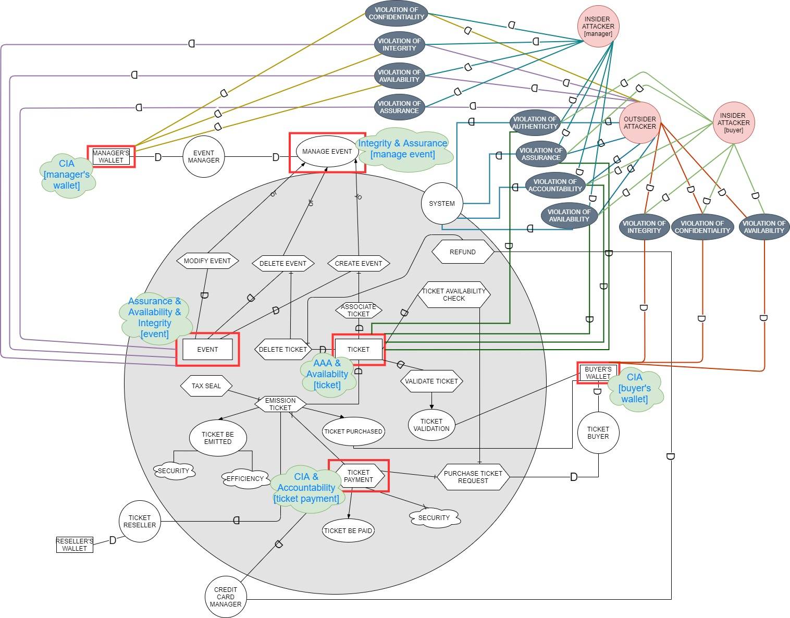
Threat identification / Attack assessment
Abuse case

Slide 12
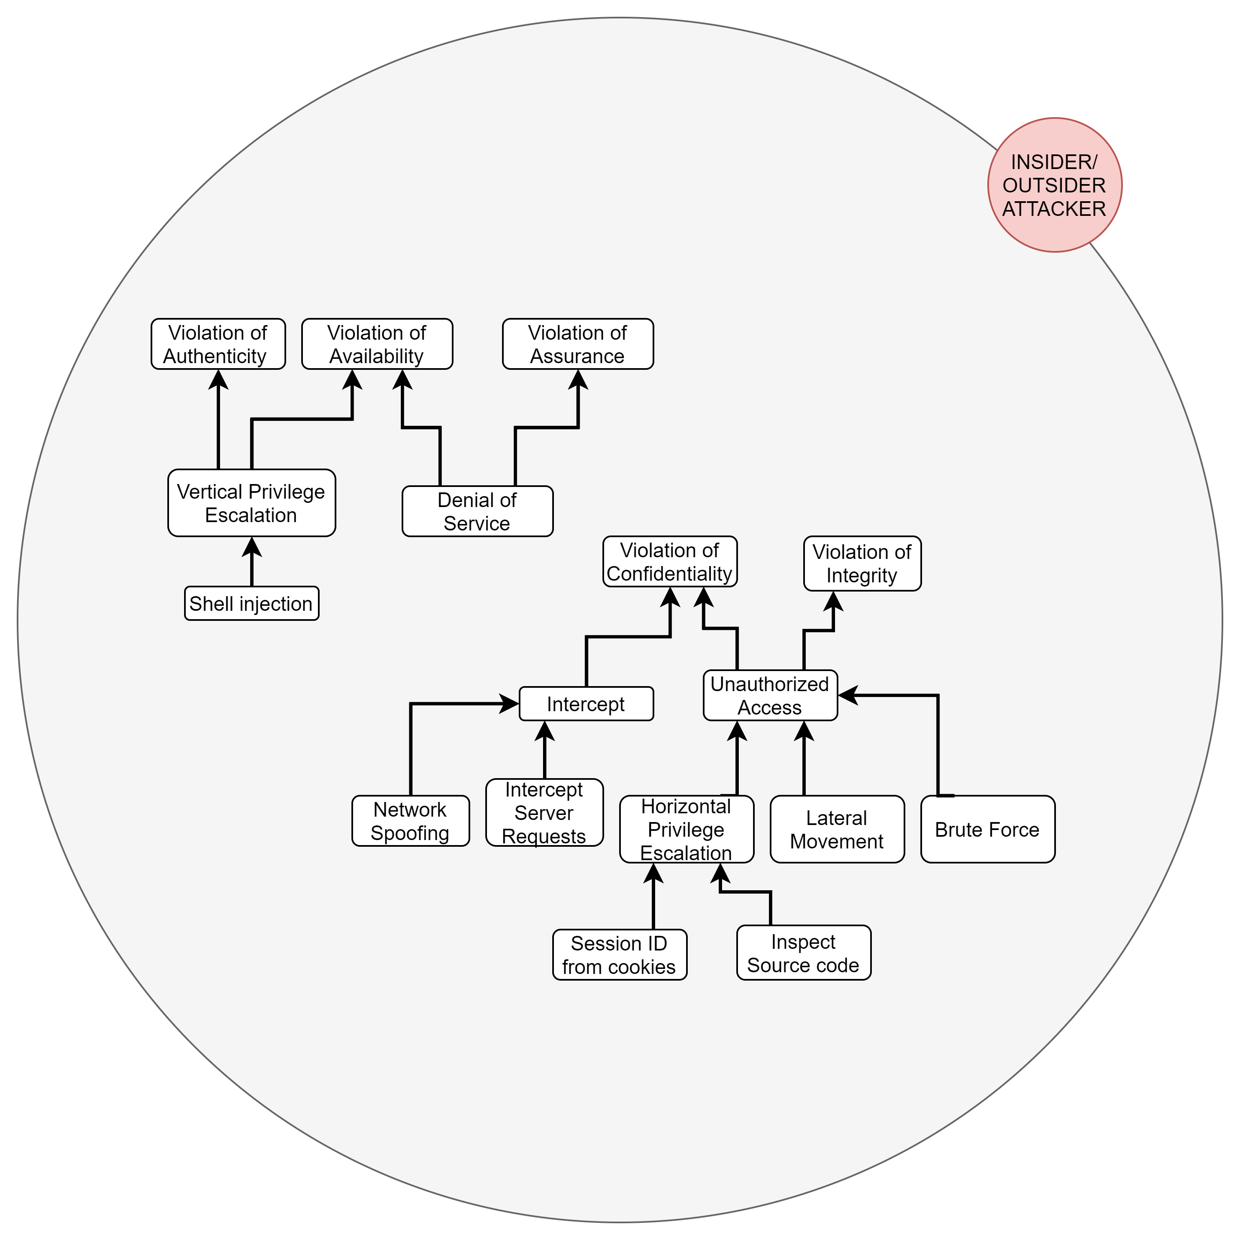
Threat identification / Attack assessment
Attack Trees

Slide 13
Threat identification / Attack assessment
Abuse Case Specification

Slide 14
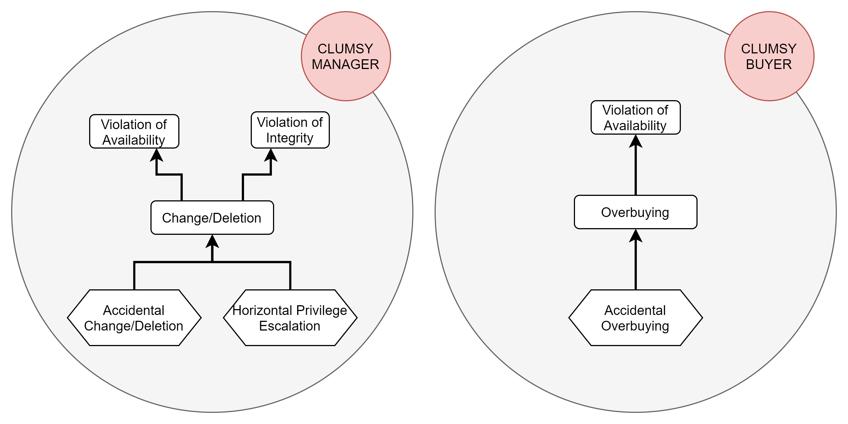
Threat identification / Attack assessment

Slide 15
Threat identification / Attack assessment
Misuse Case Specification

Slide 16
Threat identification / Attack assessment
Risk Assessment and Mitigation Table
ASSET | Spoofing | Tampering | Repudiation | Information Disclosure | Dos | Elevation of Privilege | Attack | Probability
Manager's Wallet |  |  |  | X |  |  | Intercept | 3
 | X | X |  | X |  |  | Unauthorized Access | 4
 | X | X |  | X |  | X | Vertical Privilege Escalation | 2
 |  | X |  |  | X |  | Denial of service | 4
Event | X | X |  |  |  | X | Privilege Escalation | 3
 |  | X |  |  | X |  | Denial of Service | 4
 | X | X |  |  |  |  | Unauthorized Access | 4
 | X | X |  |  |  |  | Horizontal Privilege Escalation(Clumsy Manager) | 2
 |  | X | X |  |  |  | Accidental Change or Deletion(Clumsy Manager) | 5
 | X | X |  |  |  | X | Vertical Privilege Escalation(Clumsy Manager) | 2
Ticket | X | X |  | X |  | X | Vertical Privilege Escalation | 3
 |  | X |  |  | X |  | Denial of Service | 4
 | X | X |  | X |  | X | Vertical Privilege Escalation(Clumsy Buyer) | 1
 |  |  | X |  |  |  | Overbuying(Clumsy Buyer) | 5
 | X | X |  | X |  |  | Horizontal Privilege Escalation(Clumsy Manager) | 3
 |  | X | X |  |  |  | Accidental Change or Deletion(Clumsy Manager) | 5
 | X | X |  | X |  | X | Vertical Privilege Escalation(Clumsy Manager) | 2
Buyer's Wallet |  |  |  | X |  |  | Interception | 4
 | X | X |  | X |  |  | Unauthorized Access | 4
 | X | X |  | X |  |  | Horizontal Privilege Escalation | 4
 |  | X |  |  | X |  | Denial of Service | 5
System | X | X |  | X |  | X | Vertical Privilege Escalation | 4
 |  | X |  |  | X |  | Denial of Service | 4

Slide 17
Threat identification / Attack assessment
Mitigation: STRIDE Model
Threat | Property | Control
Spoofing | Authentication | 1. Authentication protocols with complex passwords 2. Strong authentication for System User 3. Wallet authentication 4. Password hashing on DB 5. Blockchain address hashing on DB
Threat | Property | Control
Tampering | Integrity | 1. ACLs on logs 2. Data validation checks on Blockchain structures and functions 3. Web3 controls on transactions integrity 4. MySQLjs controls on query integrity (SQL injection) 5. Hashes and Encryption 6. Tamper-resistant protocols
Threat | Property | Control
Repudiation | Nonrepudiation | 1. Authentication protocols with complex passwords 2. Strong Authentication for System User 3. Secure Logging and Auditing 4. Blockchain transactions signatures 5. Secure time stamps 6. Trusted third parties 7. Nonrepudiaton possible executions
Threat | Property | Control
Information Disclosure | Confidentiality | 1. Encryption 2. ACLs 3. Privacy-enhanced protocols 4. Protected secrets 5. Not stored secrets
Threat | Property | Control
DoS | Availability | 1. ACLs 2. Throttle quotas and Blockchain timing 3. Authentication Protocols
Threat | Property | Control
Elevation of Privileges | Authorization | 1. Data execution prevention 2. Linux kernel's address space layout randomization 3. Running applications with least previlege 4. Use of compilers and try-catch structures that trap buffer overruns 5. Encryption of software components

Slide 18
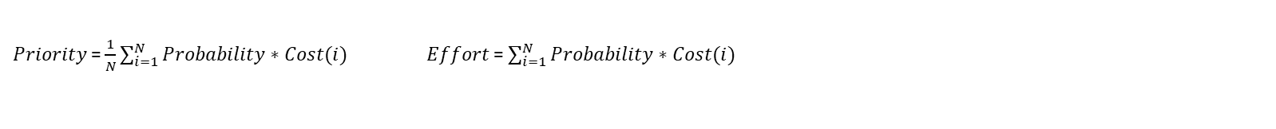
Control ident./Feasibility ass./Security req. def.
Risk Assessment and Mitigation Table
$Priority$= $\frac{1}{N}\sum_{i=1}^{N}{Probability∗Cost(i)}$ $Effort$= $\sum_{i=1}^{N}{Probability∗Cost(i)}$

Slide 19
Control ident./Feasibility ass./Security req. def.
Risk Matrix
 | Negligible (1) | Minor (2) | Moderate (3) | Significant (4) | Severe (5)
Very Likely (5) | 5 | 10 | 15 | 20 | 25
Likely (4) | 4 | 8 | 12 | 16 | 20
Possible (3) | 3 | 6 | 9 | 12 | 15
Unlikely (2) | 2 | 4 | 6 | 8 | 10
Very Unlikely (1) | 1 | 2 | 3 | 4 | 5
 | 1-->3
 | 4-->6
 | 7-->12
 | 13-->19
 | 20-->25

Slide 20
Control ident./Feasibility ass./Security req. def.
Abuse Case Specification

Slide 21
Control ident./Feasibility ass./Security req. def.
Misuse Case Specification

Slide 22
IMPLEMENTATION

Slide 23
Tools & Software Used
Visual Studio Code IDE
GoQuorum Blockchain with Quorum-Wizard tool
Bash structure
IBFT Protocol
5 nodes with asymmetric keys
ExpressJS framework
RemixIDE and Solidity
Handlebars Engine
NodeJS modules (Web3, BCryptJS, Crypto-JS, DotENV, Winston, …) with NPM vulnerability check

Slide 24
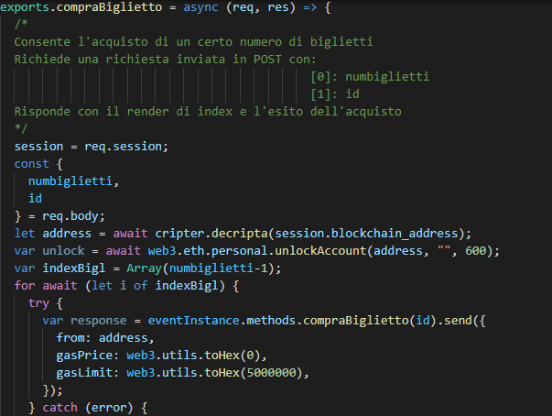
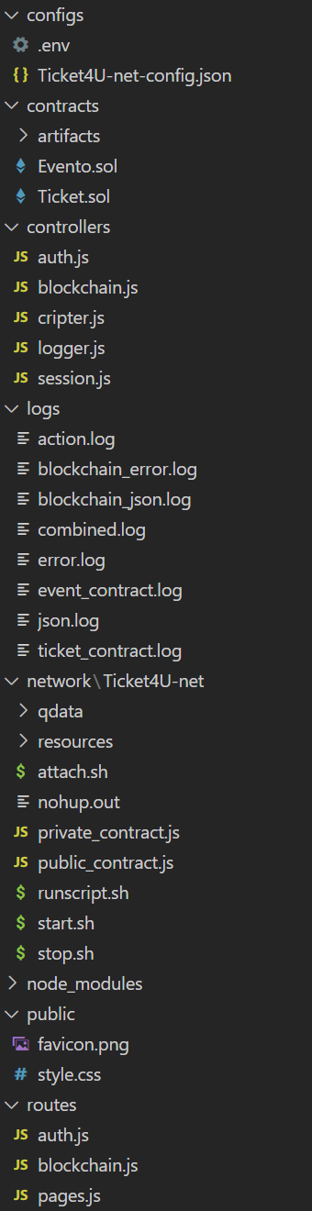
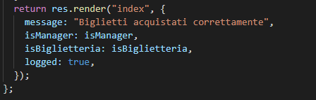
Controllers rotate around ExpressJS framework which works as a server-side and middleware application
…

Slide 25
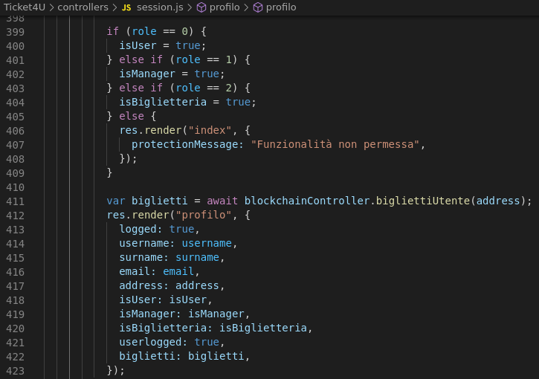
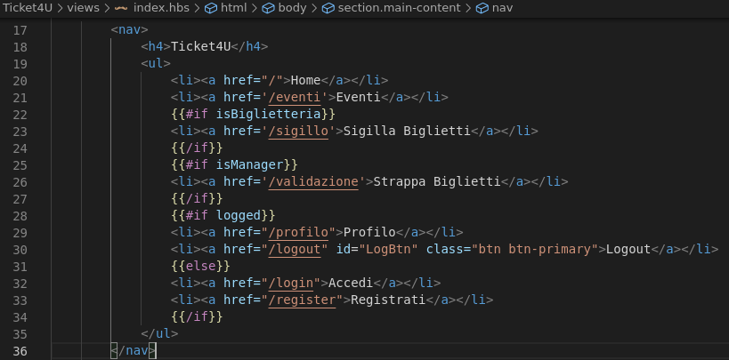
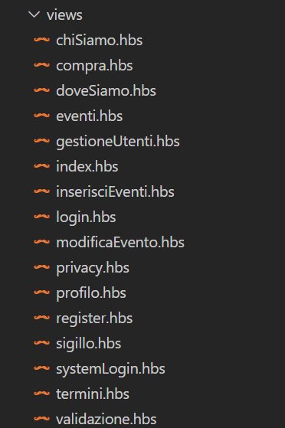
Actions not permitted to a user are excluded by server controllers and interactions with HBS view engine helpers.

Slide 26
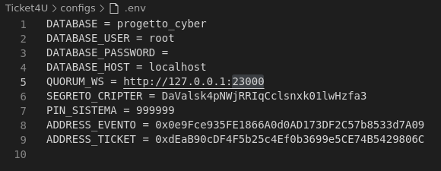
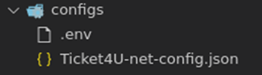
Need-to-be-secret configurations are stored in a .env file hidden behind process.env

Slide 27
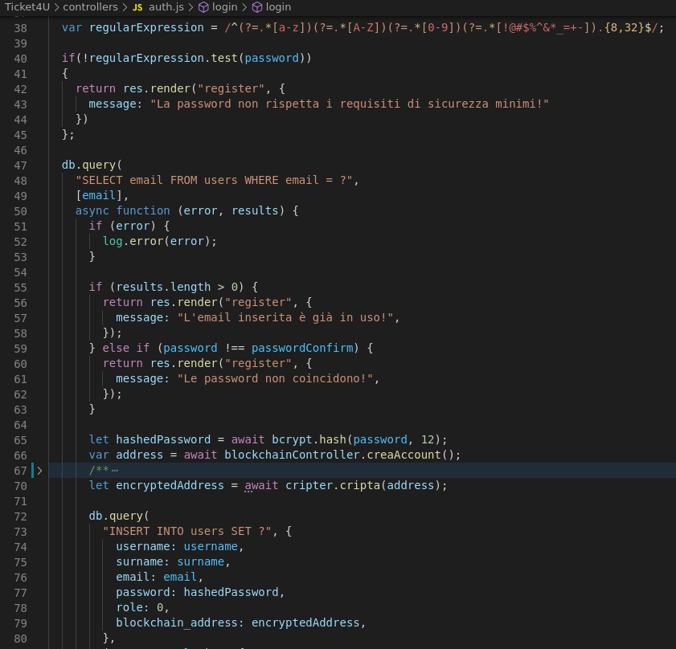
Examples of controls for the assurance of:
Password complexity
Password hashing
Information Encryption
Protection against SQL Injection
Additional Features:
Brute force
Controls for Correct Information Flow
And many others...

Slide 28
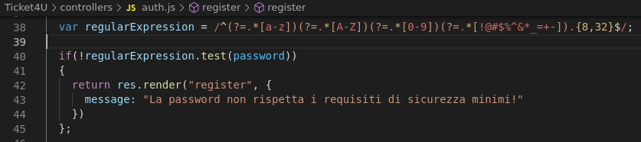
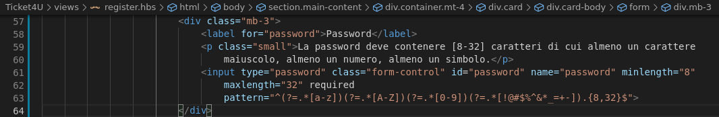
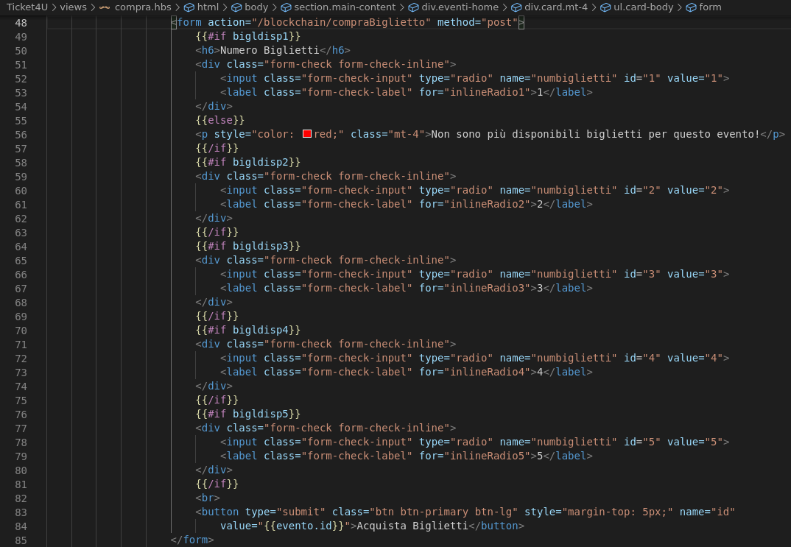
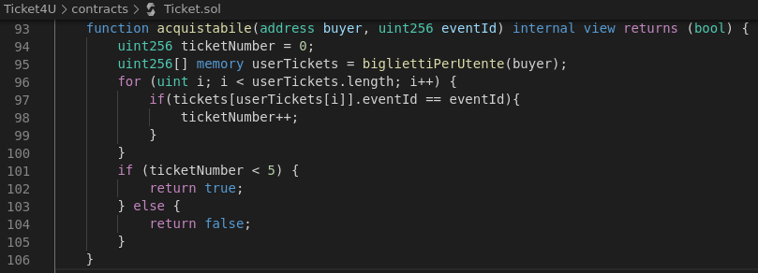
Some controls are implemented in redundancy and diversity

Slide 29
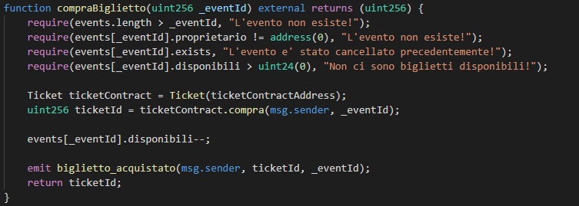
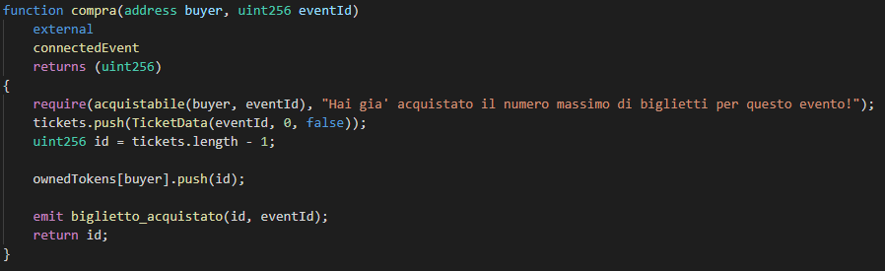
An example of a Solidity interaction between the two smart contracts, where the first requires structures and functions from the latter

Slide 30
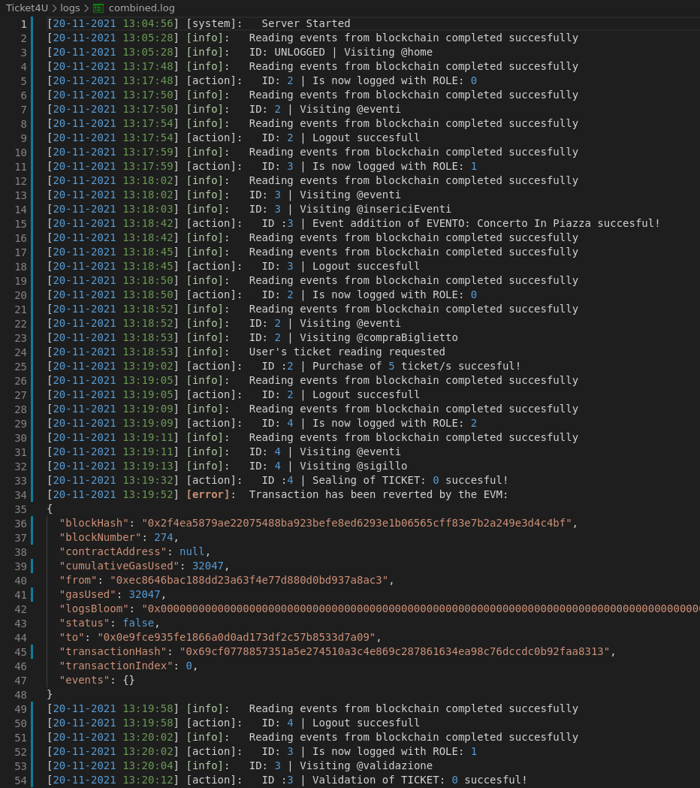
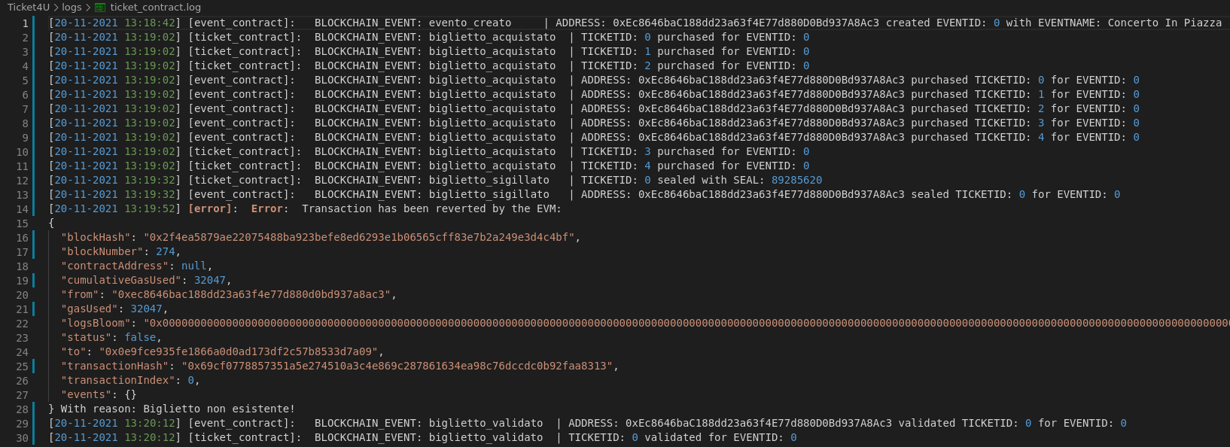
Example of Off-Chain and On-Chain logs
OFF-Chain
ON-Chain
(with Web3 Event Subscription)

Slide 31
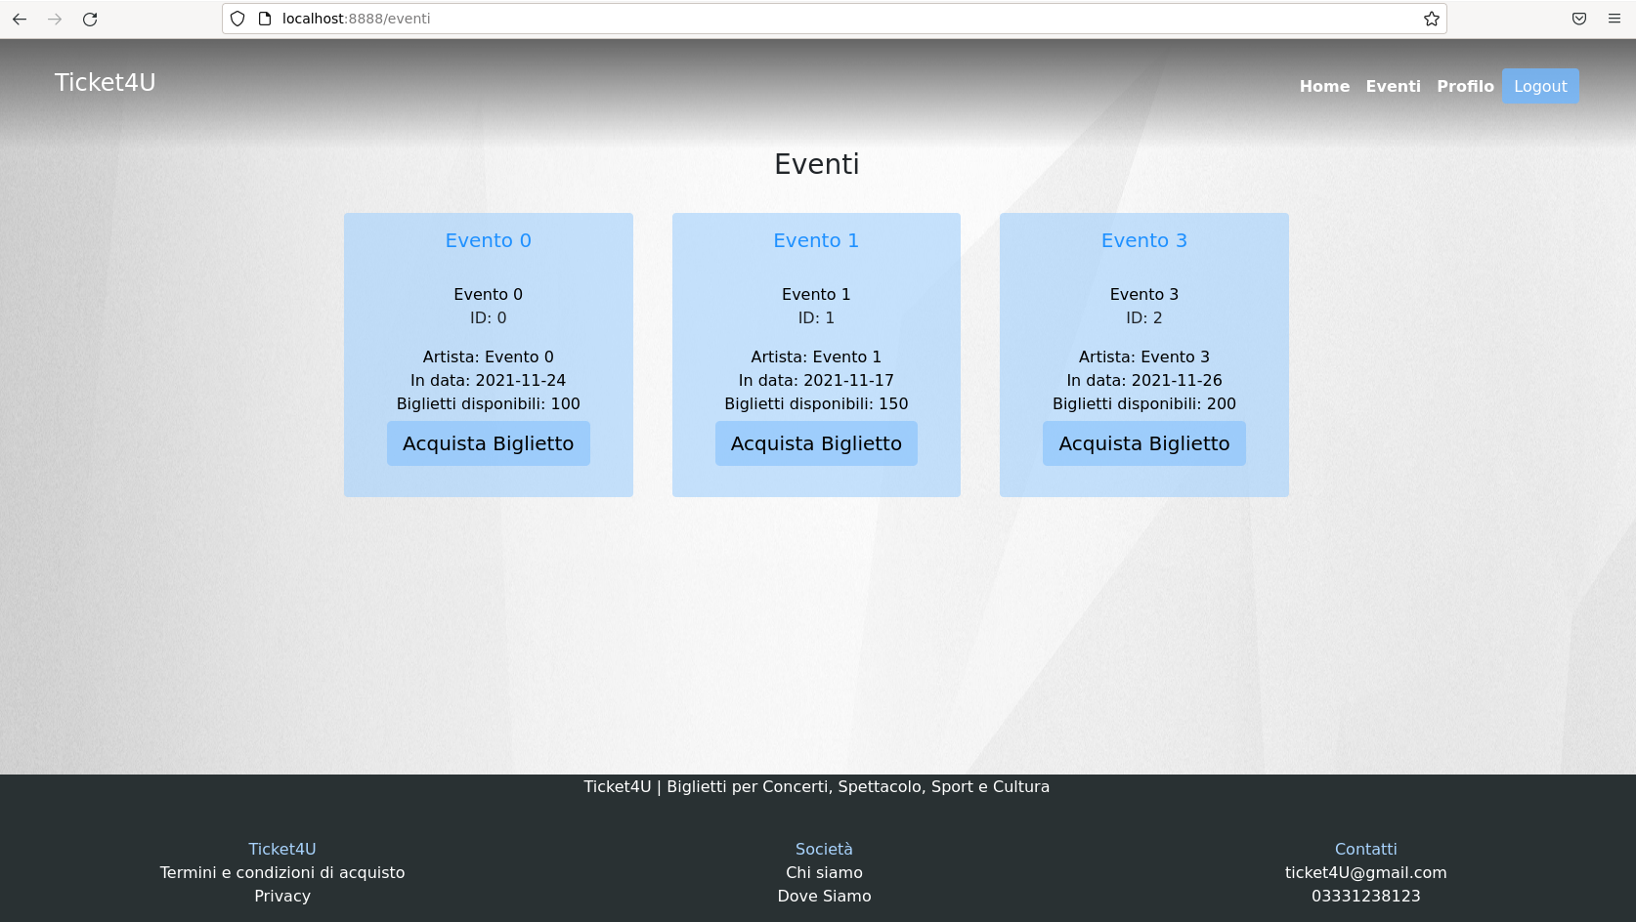

Slide 32
Thanks for your attention

